Slide 1
IR Spectroscopy Part – 1 Analytical chemistry III B.Sc, semester - 5, paper - 6
Vijaya Lakshmi Sada
Guest faculty
P.R. Govt. College (A), kakinada

Slide 2
contents
Introduction
Regions of the Infrared spectrum
principle

Slide 3
Introduction
IR spectroscopy (which is short for infrared spectroscopy) deals with the infrared region of the electromagnetic spectrum, i.e. light having a longer wavelength and a lower frequency than visible light. Infrared Spectroscopy generally refers to the analysis of the interaction of a molecule with infrared light.

Slide 4
Introduction
The IR spectroscopy concept can generally be analysed in three ways: by measuring reflection, emission, and absorption. The major use of infrared spectroscopy is to determine the functional group of molecules, relevant to both organic and inorganic chemistry

Slide 5
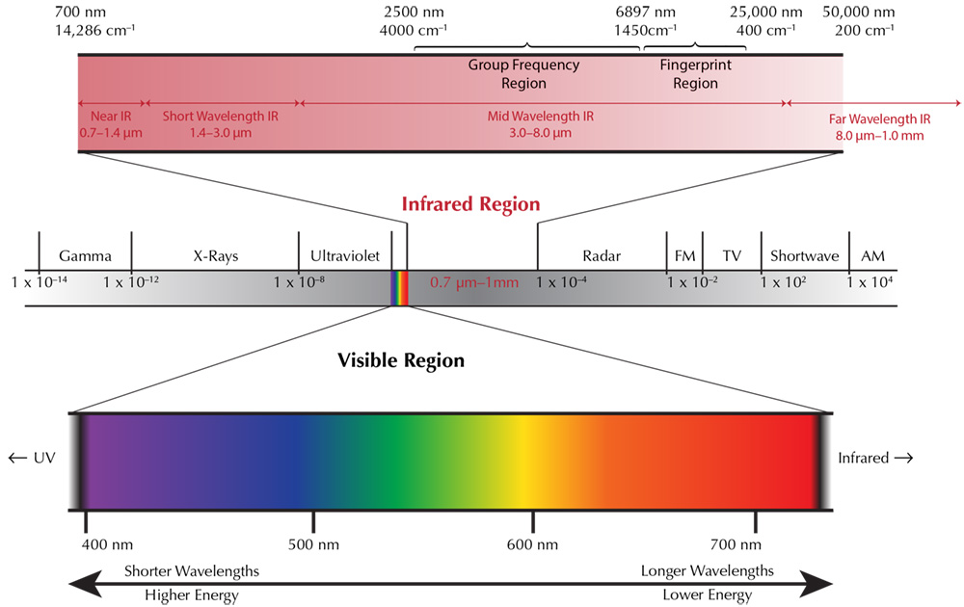

Slide 6
Regions of the Infrared spectrum:
Most of the bands that indicate what functional group is present are found in the region from 4000 cm⁻¹ to 1300 cm⁻¹. Their bands can be identified and used to determine the functional group of an unknown compound.

Slide 7
FUNCTIONAL GROUP REGION FINGERPRINT REGION
4000 cm⁻¹ – 1300 cm⁻¹ 1300 cm⁻¹ – 400 cm⁻¹
Bands that are unique to each molecule, similar to a fingerprint, are found in the fingerprint region, from 1300 cm⁻¹ to 400 cm⁻¹. These bands are only used to compare the spectra of one compound to another.

Slide 8
Principle of Infrared Spectroscopy:
IR spectroscopy works on the principle that molecules absorb specific frequencies that are characteristic of their structure. At temperatures above absolute zero, all the atoms in molecules are in continuous vibration with respect to each other. The IR spectrum of a sample is recorded by passing a beam of IR radiation through the sample.

Slide 9
Principle of Infrared Spectroscopy:
When the frequency of a specific vibration is equal to the frequency of the IR radiation directed on the molecule, the mol­ecule absorbs the radiation. The examination of the transmitted light reveals how much energy was absorbed at each frequency (or wavelength). Using various sampling accessories, IR spectrometers can accept a wide range of sample types such as gases, liquids, and solids.

Slide 10
Thank you

